Slide 1
Wk1_W: Introduction
CSCI3170 24T1
Introduction to Database Systems

Slide 2
A Gentle Revision
What do you notice?
How many observations/ records are there?

Slide 3
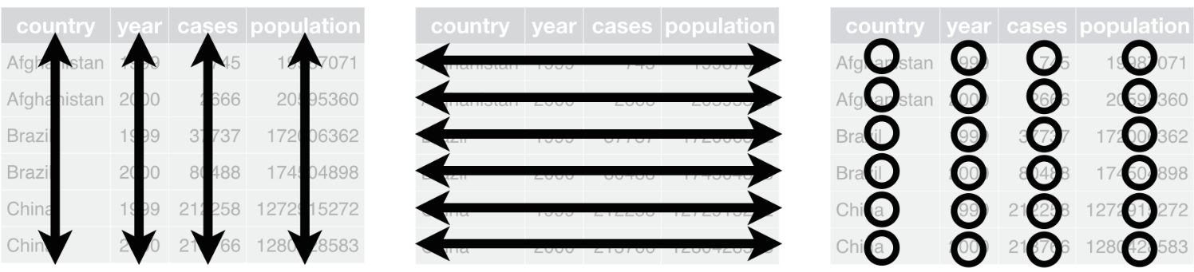
Tabular Formats
(data table/ data frame) - two dimensional structure
“Structured data is when data is in a standardized format, has a well-defined structure”
variable (attribute/field/feature)
observation (enitiy/record)
Value (data)

Slide 4
A Family of Structured Data
“Structured data is highly specific and is stored in a predefined format”
Very easily used by machine learning (ML) algorithms
https://www.ibm.com/cloud/blog/structured-vs-unstructured-data

Slide 5
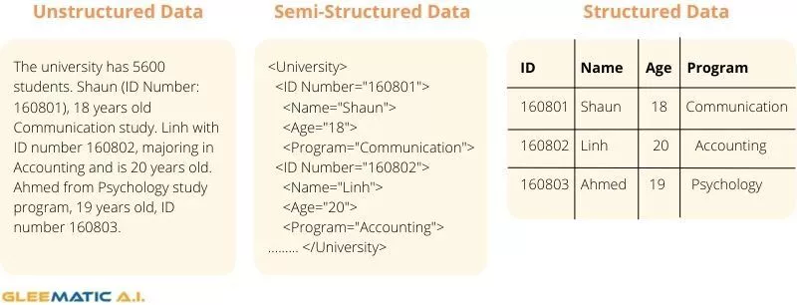
A Family of Structured Data
There are three type of data
https://cdn-dlofh.nitrocdn.com/TASgNozwGfEfVHakzcSlOaFmdxhUvEBv/assets/static/optimized/rev-f0e30d7/wp-content/uploads/2021/12/Example-Structured-Unstructured-Semi-Structured-Data-e1638423518970.jpg

Slide 6
Why Study Databases?
Most significant modern computer application rely on huge quantities of data.
Data will always have to be:
stored (typically on a disk device)
manipulated/accessed (efficiently, effectively)
shared (by many users, concurrently)
transmitted (all around the Internet)
Red points are handled by databases; brown by networks.

Slide 7
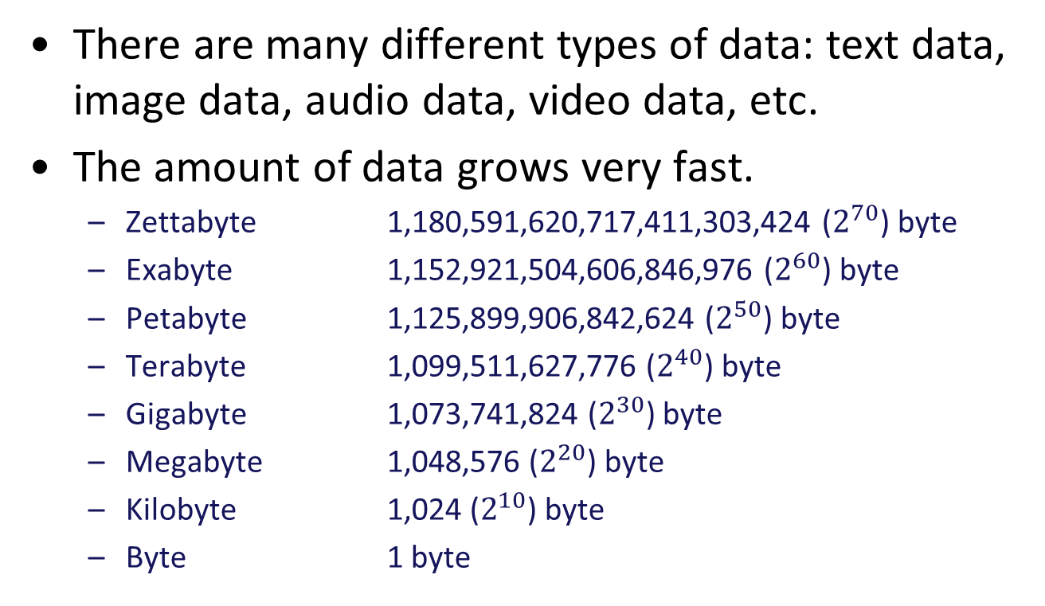
Big Data
There are many different types of data: text data, image data, audio data, video data, etc.
The amount of data grows very fast.
Zettabyte 1,180,591,620,717,411,303,424 ($2^{70}$) byte
Exabyte 1,152,921,504,606,846,976 ($2^{60}$) byte
Petabyte 1,125,899,906,842,624 ($2^{50}$) byte
Terabyte 1,099,511,627,776 ($2^{40}$) byte
Gigabyte 1,073,741,824 ($2^{30}$) byte
Megabyte 1,048,576 ($2^{20}$) byte
Kilobyte 1,024 ($2^{10}$) byte
Byte 1 byte

Slide 8
The Vs of Big Data
Volume:
The amount of data matters.
Variety:
The many types of data that are available.
Velocity:
Desire for data to be received and acted on quickly.
Veracity:
Accuracy of your data, how well it conforms to facts.
Value:
Data is of no use until that value is discovered

Slide 9

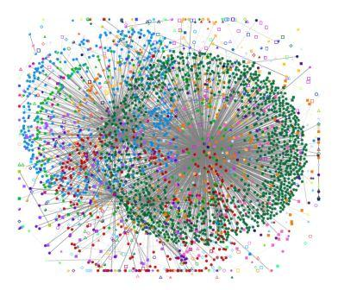
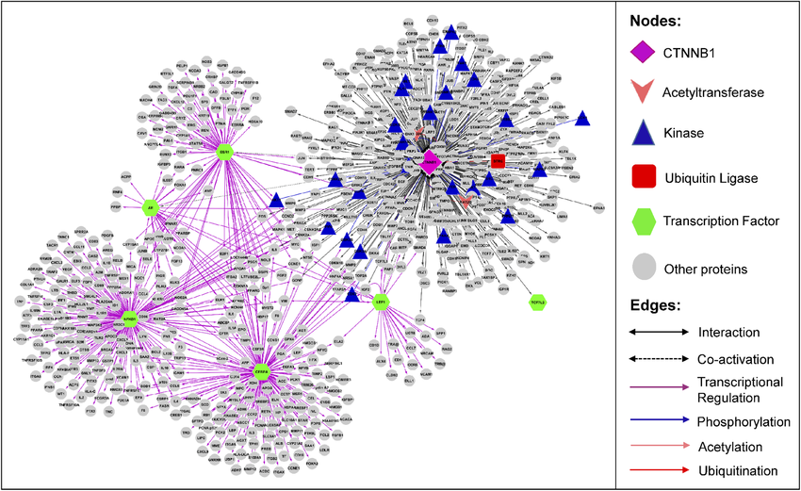

Internet of Things
Web Graphs
Biological Networks
Social Networks

Slide 10
Types of Data (Revisited)
Data that is Unstructured
No need to pre-define the data
Requires expertise to prepare the data due to its non-formatted nature
Can be a combination of various data
Data that is Structured
Stored with a rigid and strict schema
Can be organized into relational databases

Slide 11
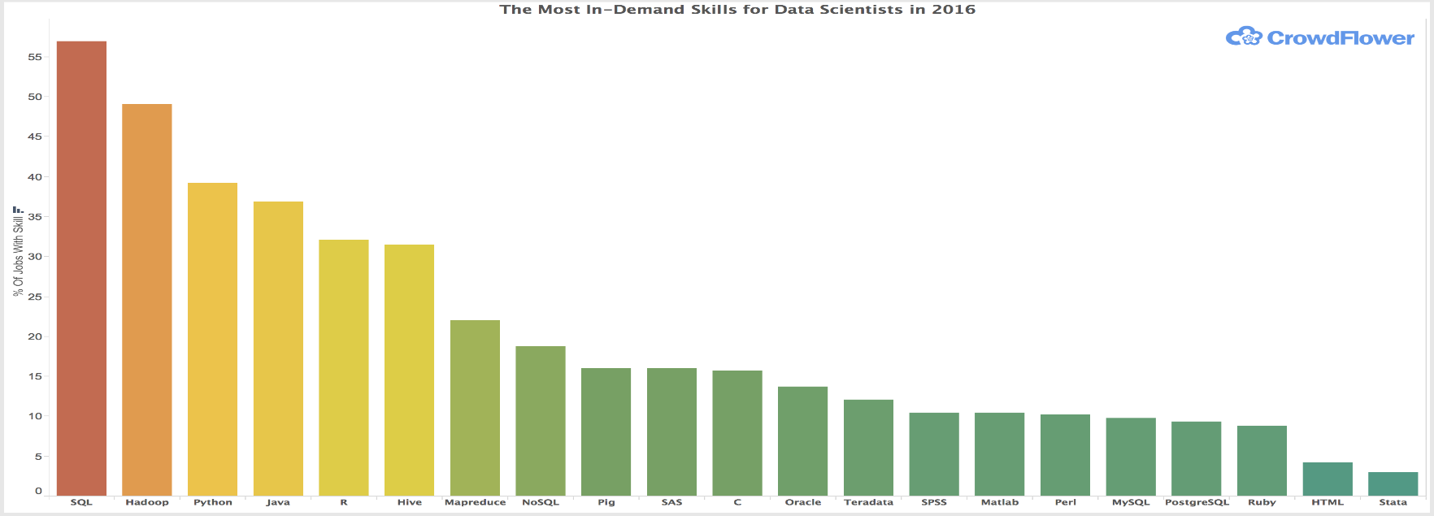
Data Science Skills Employers Want
Writing SQL Queries & Building Data Pipelines (KDnuggets 2022)
“Learning how to write robust SQL queries and scheduling them on a workflow management platform like Airflow will make you extremely desirable as a data scientist, hence why it’s point #1.”
https://www.datanami.com/2016/01/07/what-data-science-skills-employers-want-now https://www.kdnuggets.com/2021/10/11-most-practical-data-science-skills-2022.html

Slide 12
Some Resources
https://www.coursera.org/articles/sql-skills
https://www.knowledgehut.com/blog/database/database-future
https://blogs.451research.com/information_management/?s=relational+database
https://db-engines.com/en/ranking

Slide 13
Files vs. DBMS
File based system:
Contains various information on a storage device
Files (such as txt files, object files, source files)
First issue:
Data redundancy and inconsistency
Multiple file formats, duplication of information in different files
Lacking support for expressive queries
we need additional programs to answer different queries.

Slide 14
Why Database Systems (1)
Drawbacks of using file systems to store data:
Integrity problems
Integrity constraints become “buried” in program code rather than being clearly kept and stated
Hard to add new constraints or change existing ones

Slide 15
Why Database Systems (2)
Drawbacks of using file systems to store data (cont.):
Atomicity of updates
Failures may leave the data in an inconsistent state
Hard to allow concurrent access by multiple users
Uncontrolled concurrent accesses can lead to inconsistencies

Slide 16
Why Database Systems (3)
Strength of DBMS to store data (cont.):
Data Independence (to be covered later)
Application program should not be exposed to details of data representation and storage.
DBMS provides an abstract view of the data that hides such details.
Moreover, database systems offer solutions to all the aforementioned problems

Slide 17
Other Adv. of a DBMS (1)
Data Integrity and Security
DBMS can enforce access controls that govern what data is visible to different classes of users.
Concurrent Access and Crash Recovery
DBMS schedules concurrent access such that users can think of the data as being accessed by only one user at a time.
Protects users from the effects of system failures.

Slide 18
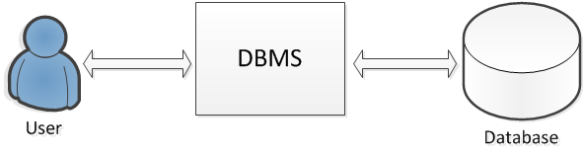
What is a DBMS?
A database management system (DBMS) is a software package designed to assist in maintaining and utilizing large collections of data.

Slide 19
Part 1: What is a Database?
A collection of data.
Typically describing the activities of one or more related organizations.
Models real-world enterprise
Entities
e.g. students, professors, courses, classroom
Relationships between entities
e.g. student's enrollment in courses, professor teaching courses, and use of room for courses.

Slide 20
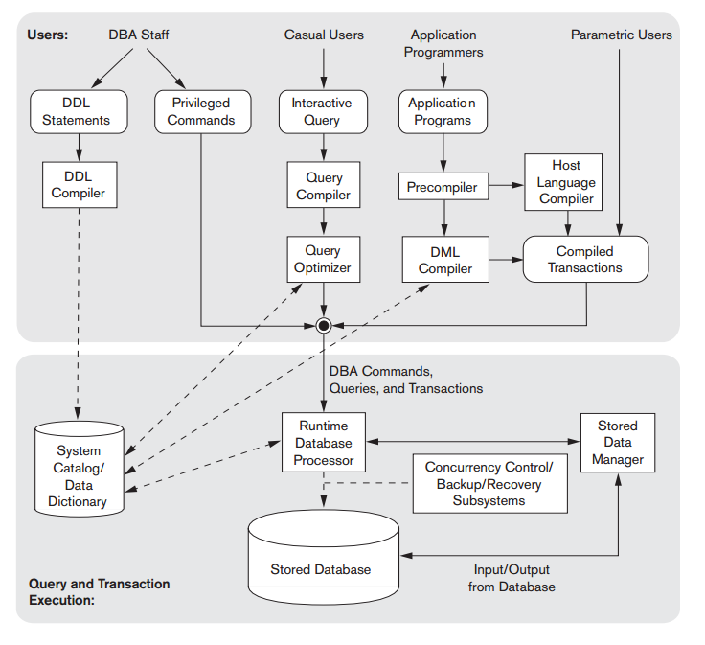
Database System
Component modules of a DBMS and their interactions.

Slide 21
People who deal with databases
Database Administrator (DBA)
The ones with central control over the database(s)
Responsible for the following tasks:
Schema definition/modification
Storage structure definition/modification
Authorization of data access
Integrity constraints specification
Database Recovery

Slide 22
People who deal with databases
Sophisticated users
Those who form request in database query languages.
Naive users
Those who invoke application programs that have been written previously e.g., transfer fund between accounts.

Slide 23
People who deal with databases
Application Programmers
Those who write programs (Cobol, C, Java) with embed DML calls or develop packages with software tools provided by the DBMS vendor.
Example: programs that generates payroll checks, transfer funds between accounts etc.
Systems Analyst
Determine end users requirements
Develop specs. for canned transactions and reports
May also take part in database design

Slide 24
Revisit Adv. of a DBMS
Data Administration
DBMS Provides facilities for
Organizing data representation to minimize redundancy
fine-tuning the storage of data to make retrieval efficient
Reduced Application Development Time
DBMS supports important functions that are common to many applications
High-level interface

Slide 25
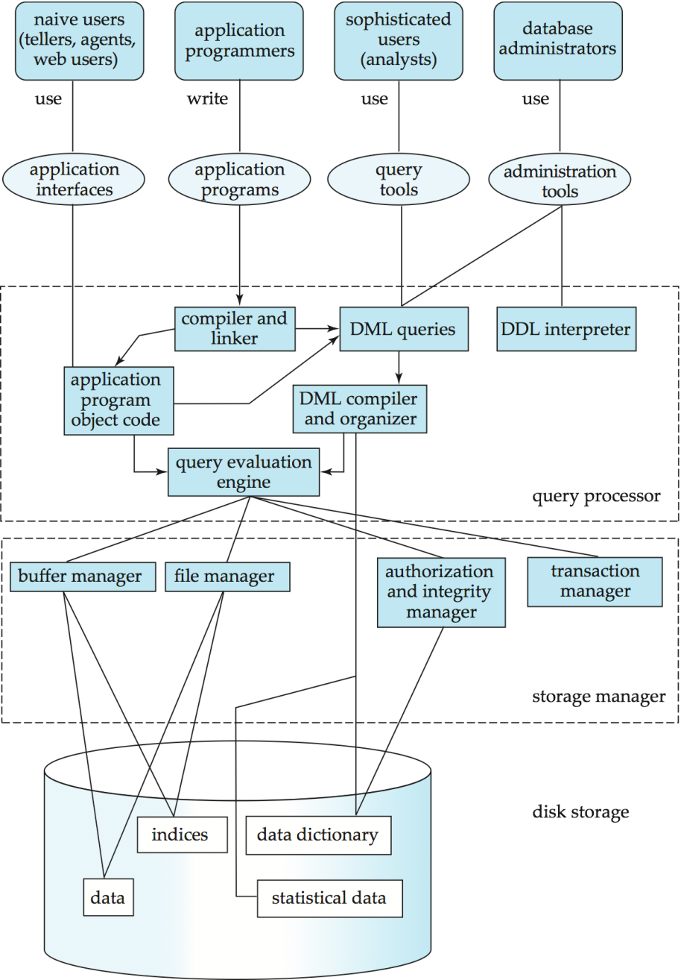
Architecture of a DBMS
Source: Database System Concept, 6th edition

Slide 26
In Conclusion
Hopefully, you now know…
course structure
who to contact (where to seek help before emailing me)
how you’re assessed and scored
the database applications around you
what goes on in databases (and is interested)
Next Week: ER Diagram, (some) Data Modelling

Slide 27
Next Week
id
Customer-street
Customer-name
Customer-city
Loan-number
amount
Borrower
Customer
Loan
An example of an ER data model

Slide 28
Data Model
Data model:
the concepts used to describe the allowed structure of a database. i.e., the structure of the data.
3 Levels of Data Models:
High-level or conceptual e.g., ER model – concerns entities, attributes and relationships (Next Week)
Implementation or record-based e.g., Relational, Network, Hierarchical
Low-level or physical

Slide 29
Data Model (cont) Concepts
Database Schema:
a formalism of the data model, the structural description of what information will database holds
Database Instance (or State):
any combination of actual information populated in the database at a particular time.
Checking understanding:
We define a database by specifying its schema.
The state is then an empty instance of the schema.
After this, each change in state is an update to the instance.

Slide 30
Semantic Data Model
A semantic data model is a very abstract, high-level data model.
For a user to come up with a good initial description of the data in an enterprise.
Entity-relationship (ER) model
A widely used semantic data model.
Allows us to pictorially denote entities and the relationships among them.

Slide 31
Relational Data Model
Most DBMS today are based on the relational data model.
Relation
the central data description construct in this model.
It can be thought of as a set of records.
A table with rows and columns.
Row – a record
Column – field, attribute.

Slide 32
sid | name | login | age | gpa
53666 | Jones | Jones@cs | 18 | 3.4
53688 | Smith | Smith@ee | 18 | 3.2
53650 | Smith | Smith@math | 19 | 3.8
53831 | Madayan | Madayan@music | 11 | 1.8
53832 | Guldu | guldu@music | 12 | 2.0
An example of a student relation
A description of data in terms of a data model is called a schema.
The schema of the above table is
Students(sid: string, name: string, login: string, age: integer, gpa: real)

Slide 33
End
Feedback is welcomed

